Slide 1

Project Title -Healthcare Analytics for Doctor Visits
Student Name-ACHHUTA NAND JHA​
College Name-GLA University​
Department-Department of Computer Engineering & Applications​
AICTE Internship Student Registration ID) : STU662a2083d78941714036867​

Slide 2

PROBLEM STATEMENT
Analyze healthcare data to identify patterns and trends in doctor visits, illness counts, insurance coverage, and other health-related factors. The goal is to use data analysis and visualization techniques to provide insights into health status, resource utilization, and demographic-based healthcare needs.

Slide 3
The Healthcare Analytics for Doctor Visits project involves analyzing data related to various factors affecting doctor visits, including income, age, gender, illness, and insurance type. By performing exploratory data analysis (EDA) on the dataset, we seek to answer questions such as:
The relationship between income and frequency of doctor visits.
How gender, age, and income level affect healthcare access and activity reduction due to illness.
The distribution of health insurance types among different demographics.
Correlations between chronic illness counts and doctor visits.
The project involves loading a dataset, cleaning and visualizing data, and identifying key insights that can help healthcare providers understand patient behavior better. The visualizations include bar charts, scatter plots, heatmaps, and pie charts to represent complex relationships clearly.
Project Description

Slide 4

WHO ARE THE END USERS?
The primary end users of this project are healthcare providers, insurance companies, and public health organizations. These stakeholders can use the insights to:
Improve healthcare access and services.
Design targeted programs for specific demographics (e.g., low-income, elderly populations).
Understand factors influencing healthcare utilization and insurance needs.

Slide 5

Technology Used
Python: For data processing and analysis.
Pandas: Data manipulation and analysis.
NumPy: Numerical computations.
Seaborn and Matplotlib: Data visualization libraries for generating various types of charts and plots.

Slide 6
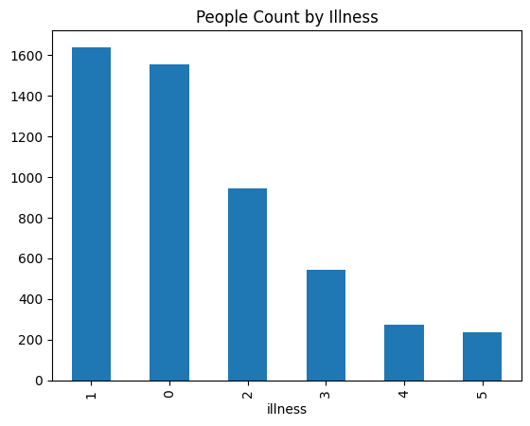
RESULTS

Slide 7
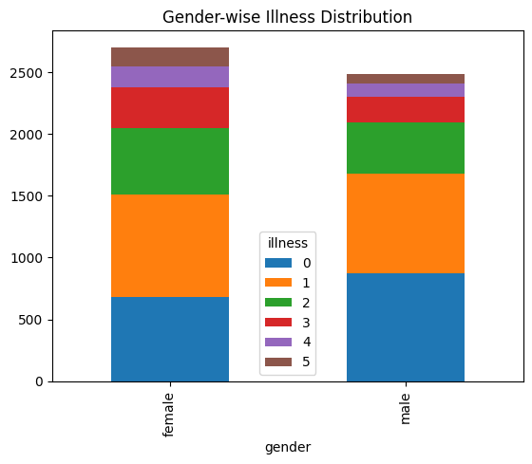
RESULTS

Slide 8
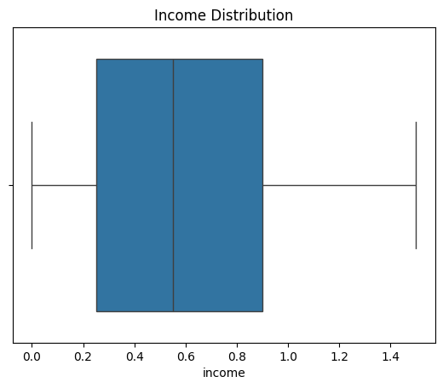
RESULTS

Slide 9
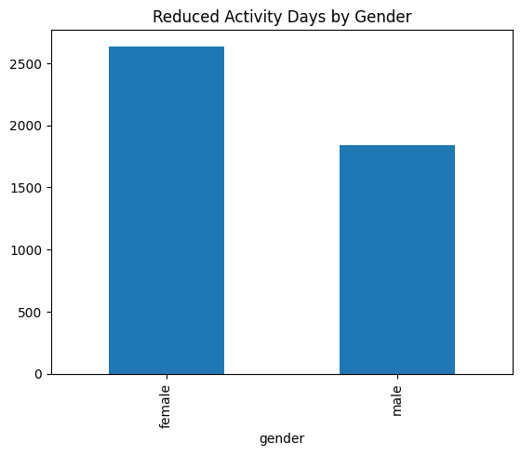
RESULTS

Slide 10
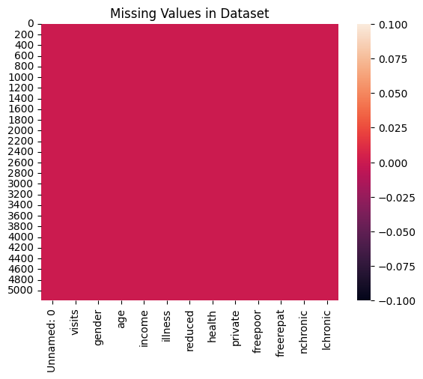
RESULTS

Slide 11
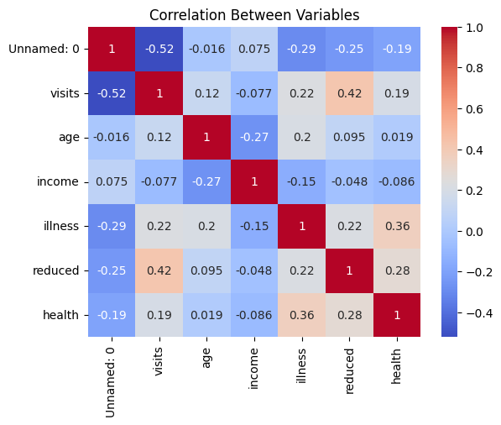
RESULTS

Slide 12
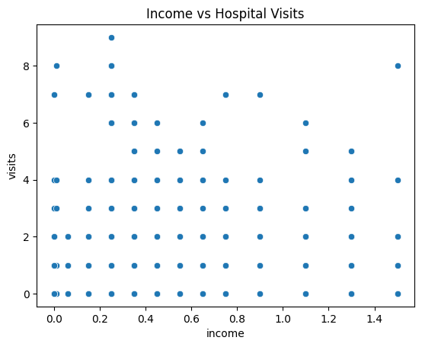
RESULTS

Slide 13
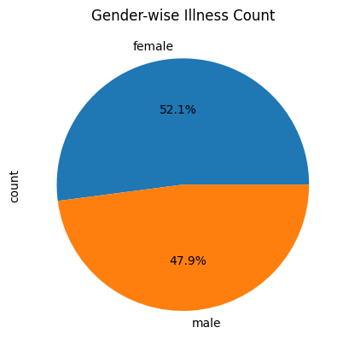
RESULTS

Slide 14
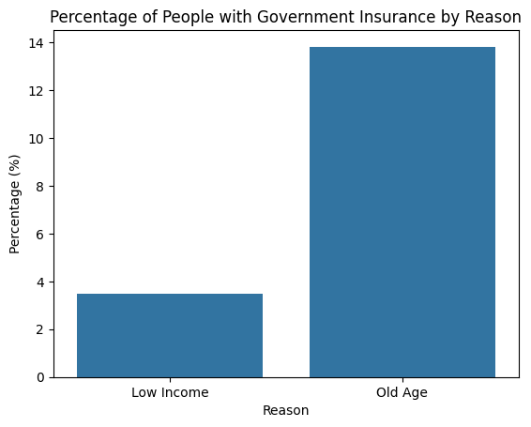
RESULTS

Slide 15
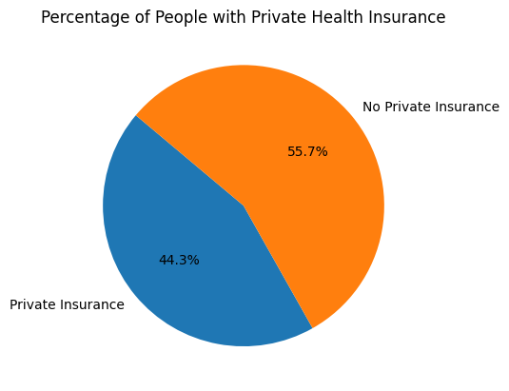
RESULTS

Slide 16
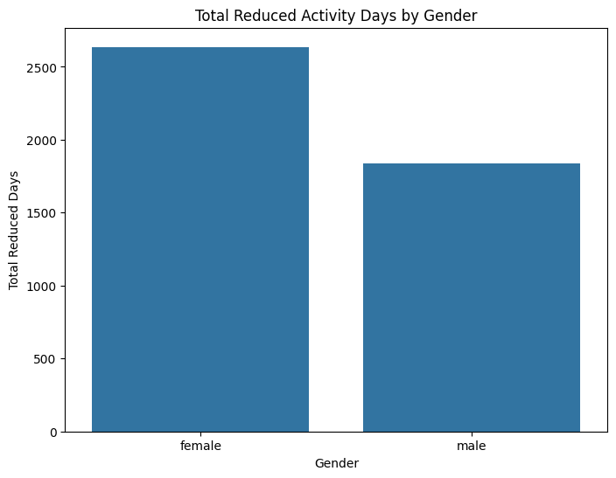
RESULTS

Slide 17
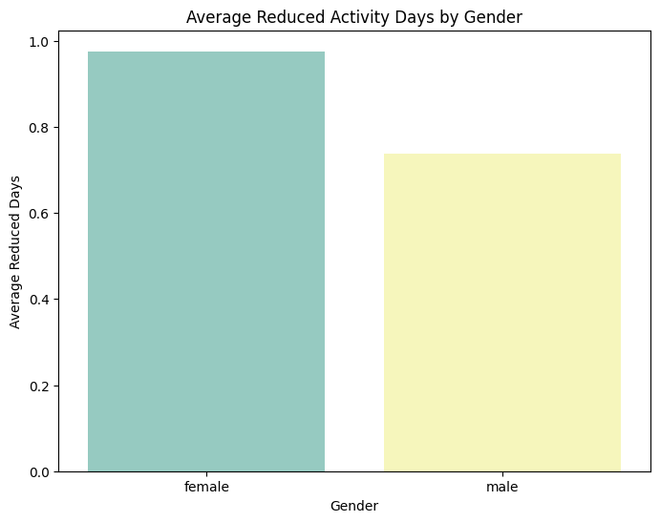
RESULTS

Slide 18
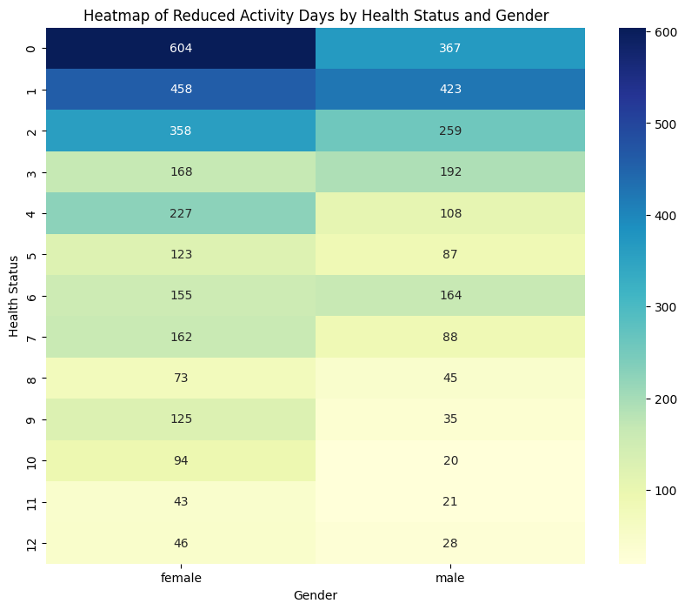
RESULTS

Slide 19
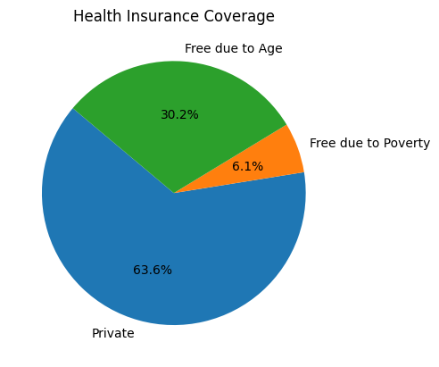
RESULTS

Slide 20
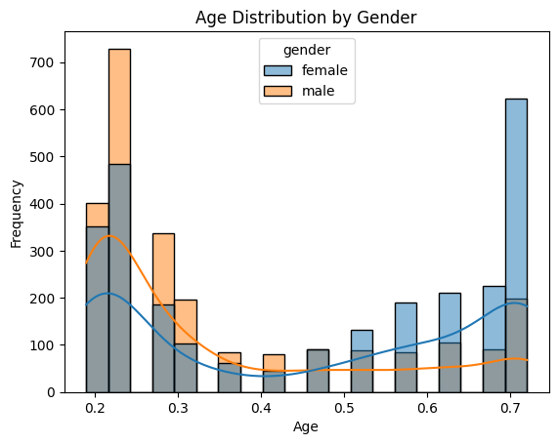
RESULTS

Slide 21
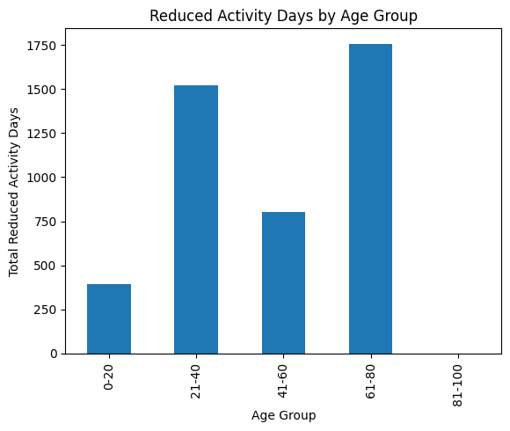
RESULTS

Slide 22
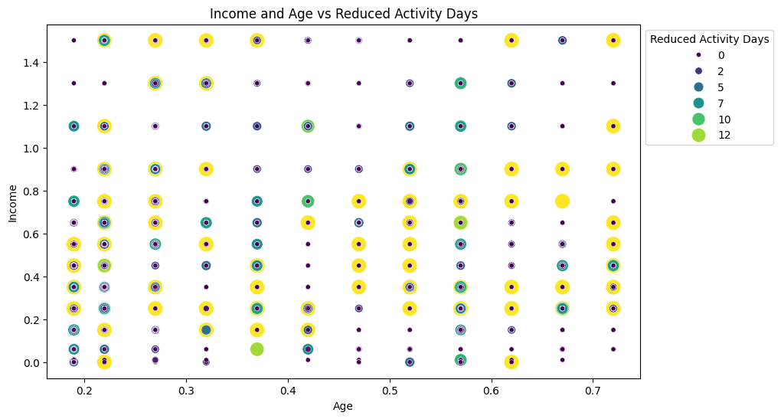
RESULTS

Slide 23
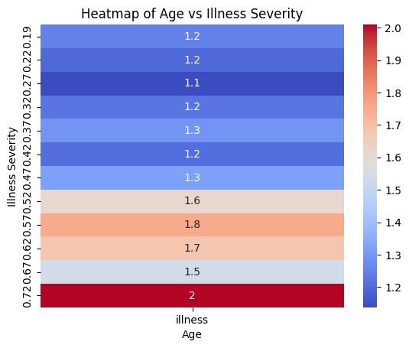
RESULTS

Slide 24
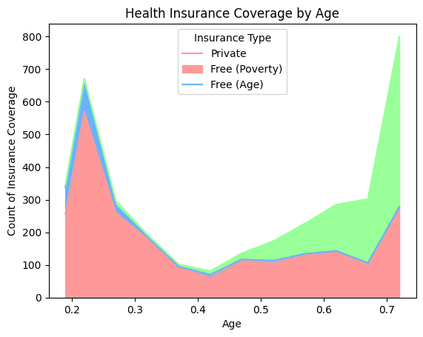
RESULTS

Slide 25
RESULTS
The analysis provides several key insights:
Gender and Illness: The distribution of illnesses across genders reveals which demographics require more healthcare attention.
Income and Doctor Visits: A scatter plot shows the correlation between income and doctor visits, highlighting how financial factors influence healthcare access.
Activity Reduction Due to Illness: Visualization of reduced activity days by age group and gender offers insights into how health conditions affect daily life.
Insurance Coverage: Analysis of government and private insurance percentages helps identify coverage gaps, particularly among low-income and elderly populations.
This project provides a foundation for further research, enabling better decision-making for healthcare policies and services.
Demo Link

Slide 26

Thank you for your attention
.
.

